Slide 1
Promises

Slide 2
Promise
A Promise is an object representing the eventual completion or failure of an asynchronous operation.

Slide 3
Create Promise
new Promise( /* executor */ function(resolve, reject) { ... } );

Slide 4
Executor
A function that is passed with the arguments resolve and reject. is executed immediately by the Promise implementation, passing resolve and reject functions.

Slide 5
Resolve/Reject
The resolve and reject functions, when called, resolve or reject the promise, respectively.

Slide 6
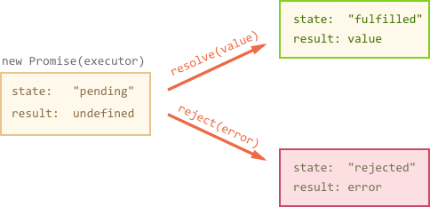
Promise object

Slide 7
Promise Tips
There can be only one result or an error. The executor should call only one resolve or reject.
The promise state change is final.
resolve/reject with more than one argument – only the first argument is used, the next ones are ignored.
Use Error objects in reject (or inherit from them).

Slide 8
Promise Tips
Properties state and result of a promise are internal. We can’t directly access them, but we can use methods .then/catch for that.

Slide 9
.then and .catch

Slide 10
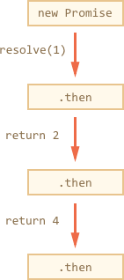
Promises chaining

Slide 11
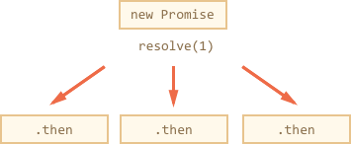
Promises chaining

